Slide 1
TYPES OF ROUTING ALGO & DISTANCE VECTOR ALGORITHM -by Hitesh Nautiyal

Slide 2
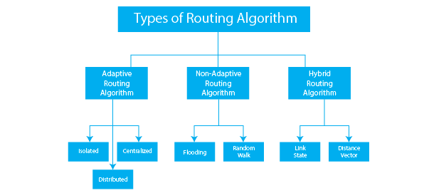
Types of Routing Algorithm :-

Slide 3
Distance Vector Routing Algorithm :-
In the distance vector routing algorithm, each node in the network has a table that records the distance and the next hop for each destination node. The table is periodically updated based on information received from surrounding nodes. The Bellman-Ford method is used to select the best route for data packets.
In the distance vector routing protocol, only distance vector information is exchanged next-hop values are not exchanged.
while creating a new routing table, only the distance vector information sis hared that to its neighbor which has a direct link. The old router tables are not taken into consideration only newly updated router information is used.
The process of updating the routing table keeps on repeating periodically to update the shortest path in case the link goes down or there is a topology change.
Distance vector routing faces an account-to-infinity problem.

Slide 4
Steps :-
Step-01:
Each router prepares its routing table. By their local knowledge. each router knows about-
All the routers present in the network
Distance to its neighboring routers
Step-02:
Each router exchanges its distance vector with its neighboring routers.
Each router prepares a new routing table using the distance vectors it has obtained from its neighbors.
This step is repeated for (n-2) times if there are n routers in the network.
After this, routing tables converge / become stable.

